Slide 1
University Placement Statistics
Team-saurabh.bhoy910_3201

Slide 2
Problem Statement
Campus Employment data in india have rarely been robust or foolproof
To address gaps, there is still no clarity over how the new idea will be computed or how they will be published
Currently there are some data and no common platform where each one can see and analyse

Slide 3
Proposed System
One Common platform where all Maharashtra’s Technical Institutes upload their data in give format
This Placement statistics platform derives knowledge for the current year in real time and also show statistics of the previous year.
It will help the government to identify area where a large number of unemployment is created and remove those unemployment by creating new job opportunity in that area, or simply providing latest skillsets which help them to start a venture or find jobs in industry
also, it will help to the university to identify industrial needs and update their courses or add some minor courses to the main course which will help to the student to a get job
it will help to the collage placement department to improve thier performance in next year

Slide 4
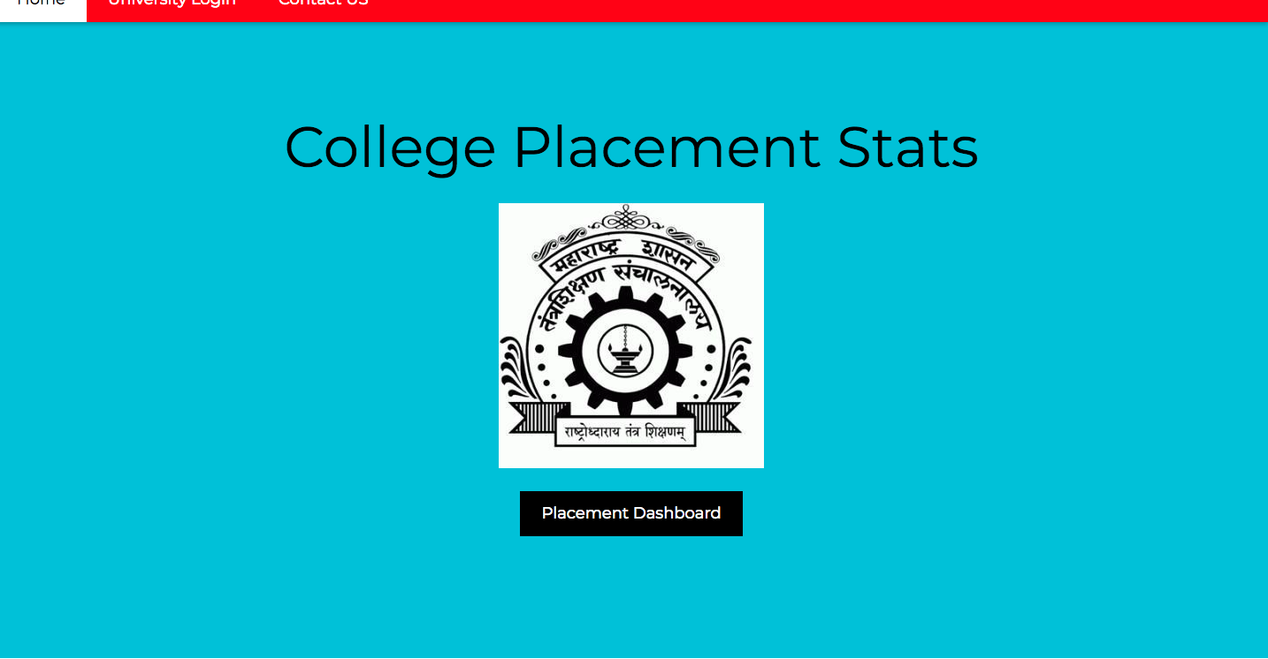

Slide 5


Slide 6
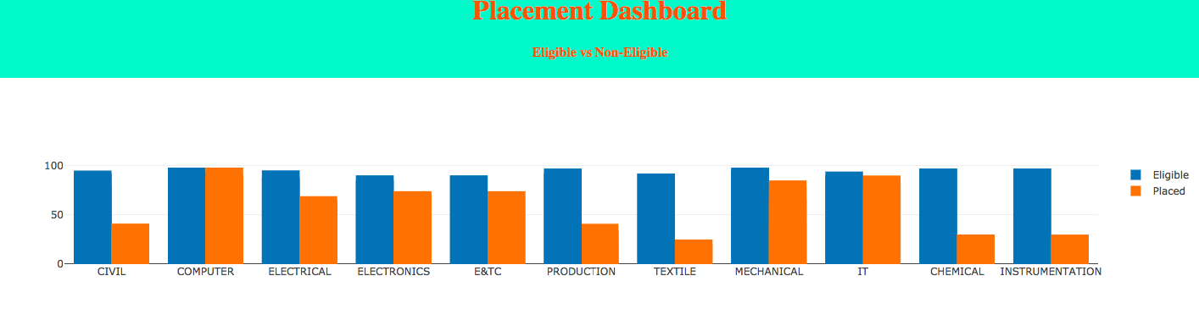

Slide 7
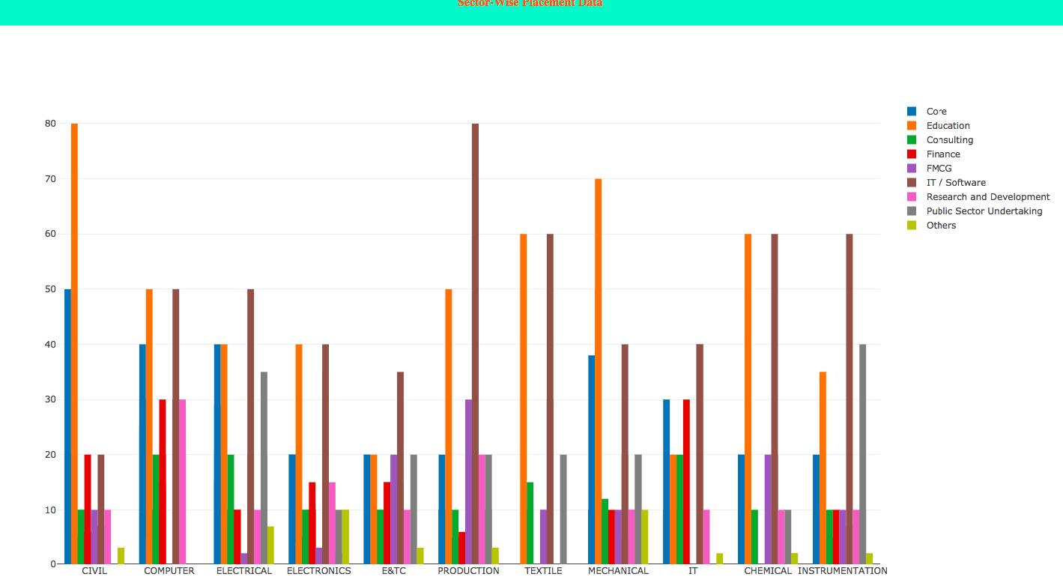

Slide 8
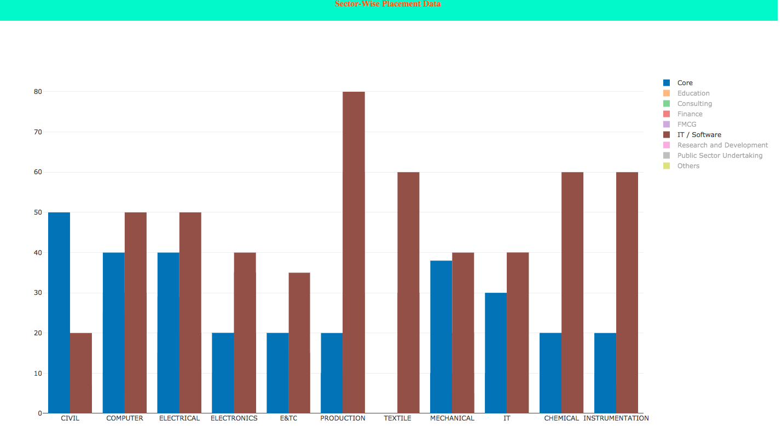

Slide 9
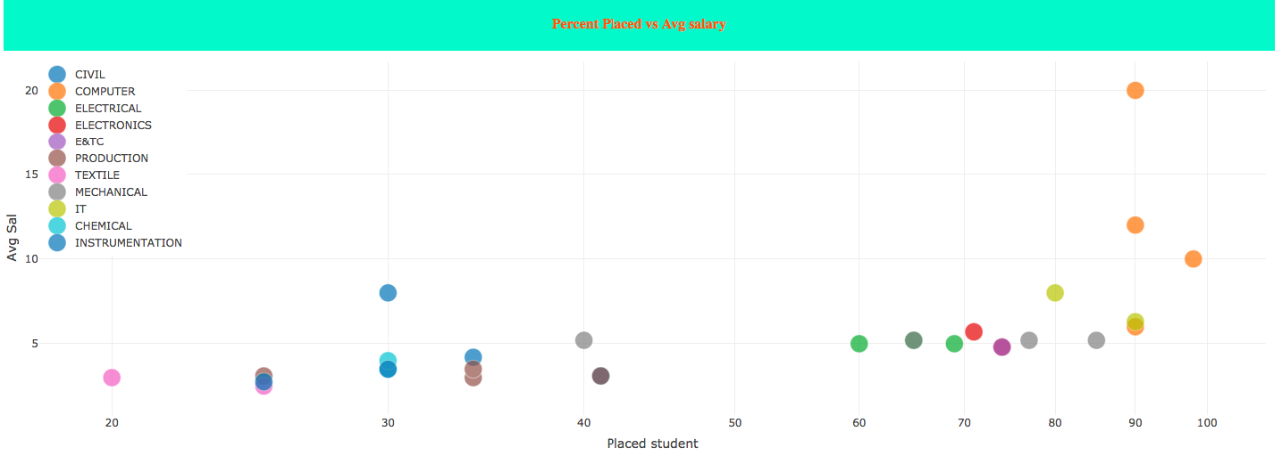

Slide 10
Thank You

